Slide 1
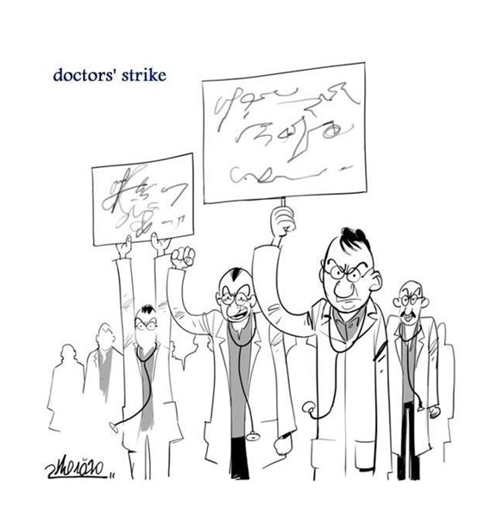
MOC Where Do We Stand:
What has improved? What still needs improvement?
Paul S. Teirstein
Chief of Cardiology
Director, Interventional Cardiology
Scripps Clinic
President, NBPAS

Slide 2
Disclosure Statement of Financial Interest
Within the past 12 months, I or my spouse/partner have had a financial interest/arrangement or affiliation with the organization(s) listed below.
Affiliation/Financial Relationship Company
President (unpaid) National Board of Physicians and Surgeons (NBPAS)

Slide 4
Physicians complained, changes were made…where no we stand now?
We had 7 Major Objections to MOC
There is no robust evidence, or even a general consensous MOC improves patient care.
MOC is onerous, ie oppressively burdensome and wastes doctors time.
All the review courses and time spent preparing for MOC tests increase costs to the physician
The multiple-choice question tests we take are often out of date, contain errors and take sides on controversial issues.
The required practice Improvement projects are onerous and a massive waste of time.
MOC annual fees are costly
It is disheartening for physicians to see their boards, once trusted organizations, to so blatantly use MOC as a revenue generator

Slide 5
Will moving to longitudinal, formative assessments solve the MOC problem?
We had 8 Major Objections to MOC
There is no robust evidence, or even a general consensous MOC improves patient care.

Slide 6
References from the Vision Commission draft report:
1. Commission report, page 25, para 5:
“The Commission heard compelling testimony from all stakeholders that loss of certification can lead to loss of employment or certain employment opportunities for diplomates or loss or reimbursement from insurance carriers.”
2. Commission report, page 9, para 5:
The report documents the Vision Commission’s own survey of 34,616 physicians on MOC.
“When physicians were asked if they valued MOC, approximately one in 10 physicians (12%) said they valued the program.”
3. Commission report, page 28, para 3:
“There are gaps in the research evidence that conclusively demonstrate that diplomate participation in continuing certification leads to better patient outcomes.”
See NBPAS.org “Journal Club”

Slide 7
Will moving to longitudinal, formative assessments solve the MOC problem?
We had 8 Major Objections to MOC
There is no robust evidence, or even a general consensous MOC improves patient care.
There will never be Level A randomized data on MOC
I propose one “reasonable” metric:
ABMS member boards should be able to present an honest survey that shows at least 75% of their diplomates-
1) think MOC helps them become better physicians
2) think MOC is worth the time, effort and money
75% -- thats only a “C+”

Slide 8
Vision Commission Report came up with numerous “FINDINGS” and 15 “RECOMMENDATIONS”
1. Commission report, page 25, para 5:
“The Commission heard compelling testimony from all stakeholders that loss of certification can lead to loss of employment or certain employment opportunities for diplomates or loss or reimbursement from insurance carriers.”
2. Commission report, page 9, para 5:
The report documents the Vision Commission’s own survey of 34,616 physicians on MOC.
“When physicians were asked if they valued MOC, approximately one in 10 physicians (12%) said they valued the program.”
3. Commission report, page 28, para 3:
“There are gaps in the research evidence that conclusively demonstrate that diplomate participation in continuing certification leads to better patient outcomes.”
4. Commission report, page 14, para 9:
“Diplomates cited that the content of the examination was not relevant, was not a reflection of the application of knowledge in the clinical environment and was not current with advances in medicine.”
5. Commission report, page 15, para 1:
“Diplomates routinely access medical knowledge on their computers and smartphones while providing patient care. Assessments that rely exclusively on knowledge recall are not aligned with how diplomates practice.”

Slide 9
Will moving to longitudinal, formative assessments solve the MOC problem?
We had 8 Major Objections to MOC
There is no robust evidence, or even a general consensous MOC improves patient care.
MOC is onerous, ie oppressively burdensome and wastes doctors time.

Slide 10
RECOMMENDATION 2: Supports Longitudinal, Formative Assessments
Summative Assessment: You get a grade and you can fail
Formative Assessment: The assessment is designed to inspire learning. Answers to questions are immediately available with clear rationale and links to further information.
Longitudinal Assessment: Assessments occur at regular time intervals throughout the year, ie Weekly or monthly questions get sent to your mobile device
In response to the massive anti-MOC sentiment, most ABMS member boards have moved from summative to longitudinal, formative assessments.
-Anesthesia (MOCA minute—monthly questions...you wont fail) and
-OB/GYN (monthly literature reviews) were early adopters.
- Radiology is now moving to Online Longitudinal Assessment
-Internal Medicine (ABIM) has finally agreed to offer longitudinal, formative assessments…no details yet.

Slide 11
Will moving to longitudinal, formative assessments solve the MOC problem?
We had 8 Major Objections to MOC
There is no robust evidence, or even a general consensous MOC improves patient care.
MOC is less onerous, less burdensome and less wastefull of doctors time. --- “Do the OLA make us better doctors?”

Slide 12
Will moving to longitudinal, formative assessments solve the MOC problem?
We had 8 Major Objections to MOC
There is no robust evidence, or even a general consensous MOC improves patient care.
MOC is onerous, ie oppressively burdensome and wastes doctors time.
All the review courses and time spent preparing for MOC tests increase costs to the physician

Slide 13
Will moving to longitudinal, formative assessments solve the MOC problem?
We had 8 Major Objections to MOC
There is no robust evidence, or even a general consensous MOC improves patient care.
MOC is onerous, ie oppressively burdensome and wastes doctors time.
All the review courses and time spent preparing for MOC tests increase costs to the physician
The multiple-choice question tests we take are often out of date, contain errors and take sides on controversial issues.

Slide 14
Will moving to longitudinal, formative assessments solve the MOC problem?
We had 8 Major Objections to MOC
There is no robust evidence, or even a general consensous MOC improves patient care.
MOC is onerous, ie oppressively burdensome and wastes doctors time.
All the review courses and time spent preparing for MOC tests increase costs to the physician
The multiple-choice question tests we take are often out of date, contain errors and take sides on controversial issues.
The required Practice Improvement Projects are onerous and a massive waste of time.

Slide 15
-- Commission report, page 17, para 3:
”It is acknowledged that measuring practice improvement can be challenging.”
--Commission report, page 19, 3rd para:
“The Commission appreciated the practical and significant difficulty placed on diplomates for meeting practice improvement requirements.”
--Commission report, page 19, 3rd para:
“…diplomates did not find value in check box activities or activates not relevant to practice. Diplomates complained that requiring multiple PDSA (Plan-Do-Study-Act) cycles in a quality improvement activity or requiring improvement in an activity in order for the activity to count in the certification program was onerous and artificial.”

Slide 16
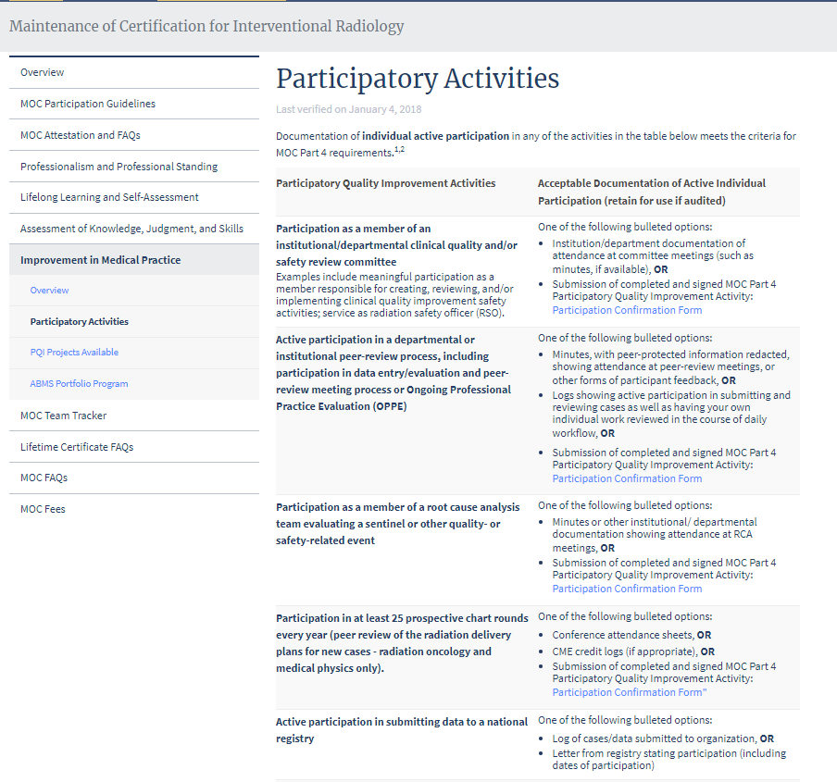

Slide 17
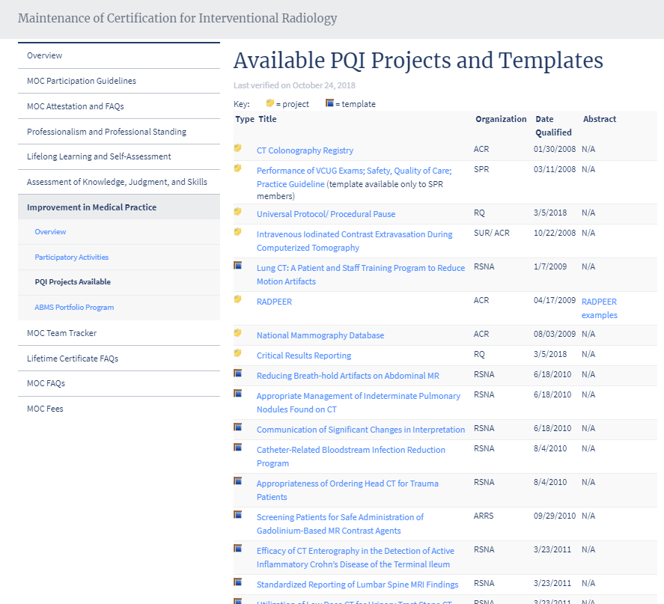
Please don’t tell me, “I’m already doing it.”
If I am already doing it don’t make me spend 3 hours proving it to you!

Slide 18
Will moving to longitudinal, formative assessments solve the MOC problem?
We had 8 Major Objections to MOC
There is no robust evidence, or even a general consensous MOC improves patient care.
MOC is onerous, ie oppressively burdensome and wastes doctors time.
All the review courses and time spent preparing for MOC tests increase costs to the physician
The multiple-choice question tests we take are often out of date, contain errors and take sides on controversial issues.
The required practice Improvement projects are onerous and a massive waste of time.
MOC annual fees are costly
It is disheartening for physicians to see their boards, once trusted organizations, to so blatantly use MOC as a revenue generator

Slide 19
This is all publicly available information.
“American Board of Radiology 990”

Slide 22
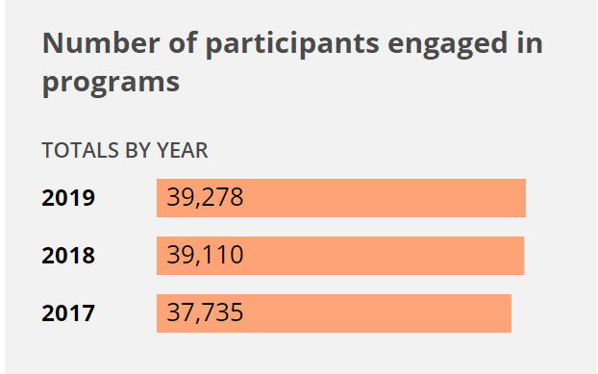
Of the nearly 40,000 ABR certified radiologists, 10,000 are grandfathered and do not pay for MOC
30,000 pay for MOC

Slide 23
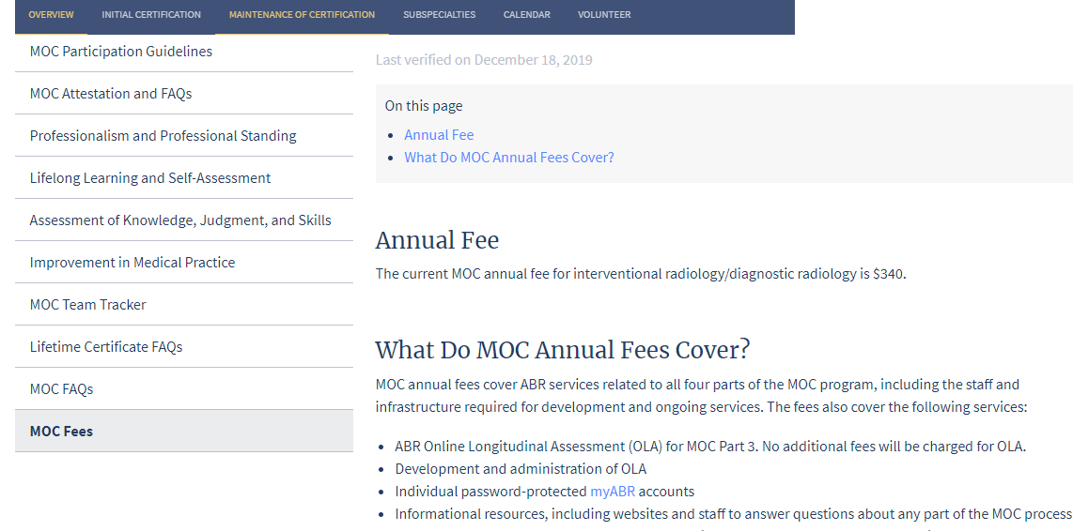
30,000 diplomates do MOC x $340/yr = $10.2M/yr

Slide 24
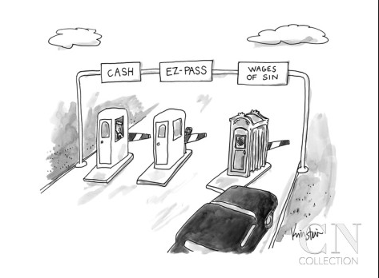
The Toll Booth of MOC Do the Math
“So…
If you don’t know…
now you know!”
NOTORIUS B.I.G.
ABR has 40,000 diplomates
Total revenue in 2018 = $14.1M
30,000 diplomates did MOC in 2018
30,000 x $340 = $10.2M from MOC,
So, $4M came initial certification, $10M from MOC
Approx 25% of docs are “grandfathers”who are exempt from MOC. In 5-10 years when they retire:
All 40,000 ABR diplomates will do MOC
40,000 x $340 = $13.6M from MOC
+ $4M from initial certification. Total revenue = $18M
MOC takes the ABR from a $4M to an $18M corporation!
And still, there is no real evidence or even a general consensus that MOC improves patient care!
THE ELEPHANT IN THE ROOM
We don’t want to be impolite and talk about money, but…
How can the fact that MOC causes ABRs annual revenue to increase from $4M to $18M, NOT be part of this conversation?
The CONFLICT OF INTEREST is just too enormous

Slide 26
The CEO of the ABR just told why she thinks MOC is so important for medicine
I just showed how in 2018, MOC took ABR’s revenue from $4M to $14M
If ABR’s revenue had been confined to the $4M it receives from initial certification, do you think its CEO could be paid $739,031?
How can someone with such a direct financial interest in MOC, be dictating what 40,000 physicians have to do to stay current?
We often hear we are fortunate to have the “privilege of self regulation.”
But is this really “self regulation” or is it actually
“self-serving regulation” by a private,
non-governmental company.

Slide 27
Why are physicians held to a more stringent standard than American Board of Radiology board members?

Slide 28
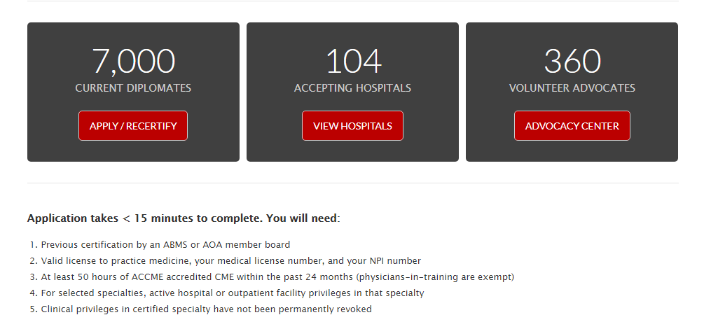
What more does ABR require?
--- Formative tests which you can fail without losing certification
--- Practice Improvement Modules that are either worthless or we already do them
--- 4x the annual fees
What more does NBPAS require?
---For procedural specialties, active hospital/facility privileges
---Clinical privileges must have not been permanently revoked.
---1/4 the annual fees

Slide 29
National Board of Physicians and Surgeons (NBPAS) is an alternative certification board intended to provide choice and disrupt the monopoly of the ABMS Member Boards.
NBPAS supports initial ABMS member board certification and requires it for continuing NBPAS certification.
NBPAS opposes the testing and time-wasting administrative tasks required by MOC and replaces them with ACCME accredited CME
www.NBPAS.org

Slide 30
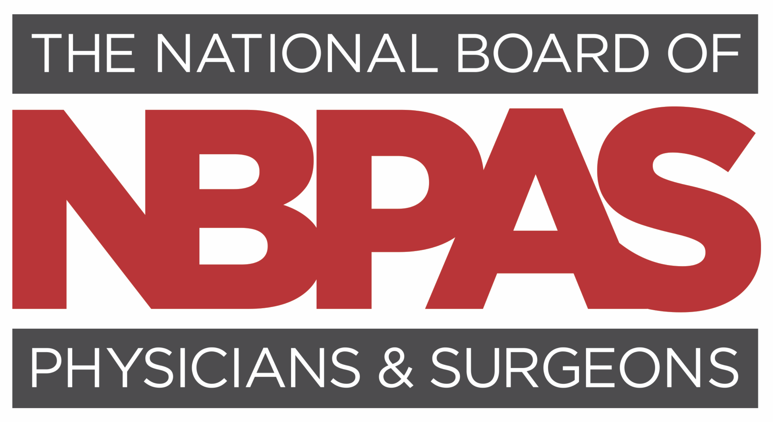
NBPAS Fees and Application
NBPAS is a not for profit 501(c)(3) organization
Board members are high profile, thought leaders representing most ABMS/AOA specialties
Fees are very low, only cover costs ($450,000 annual revenue equals its expenses)
Physician management and board members are unpaid
Governance: transparent, not-for-profit, two year board terms, COI protections
www.NBPAS.org

Slide 31
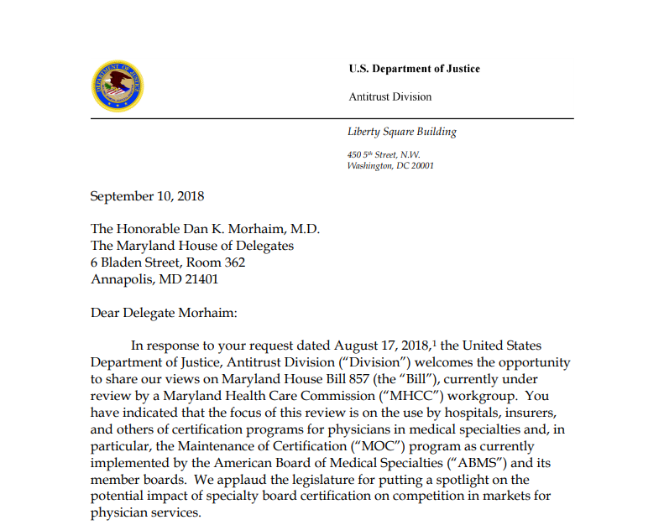
DOJ opinion letter on MOC states MOC may have the effect of “harming competition and increasing the cost of healthcare services”
ABMS may do so “by imposing overly burdensome conditions on physicians who wish to maintain their certification.”
DOJ opinion letter encourages competition in certification

Slide 32
Monopolies increase costs and inefficiencies FOR ALL STAKEHOLDERS.
What can you do to help?
Help increase hospital acceptance of NBPAS for admitting privileges
Go to your MEC and make the case
Use the enormous resources at NBPAS.org
Petition your societies (radiology societies, CMA, AMA) to support NBPAS.
Society leaders are inherently conservative and risk adverse, they don’t like big changes. Rank and file members MUST push their leaders.
Join NBPAS!
Notes:
8 patients aborted/2 pt double counted

Slide 33
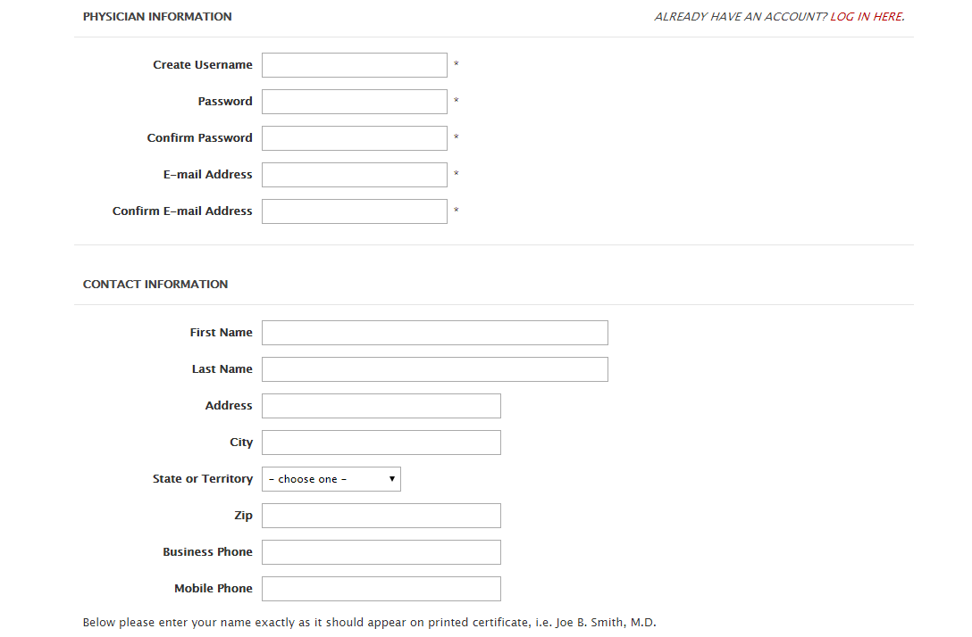
Simple application takes <15 minutes to complete
Cost is $169 for two years. Then goes down.

Slide 34
www.NBPAS.org

